Slide 1
Conducting A Single-Cell Analysis (Data Processing to Clustering)
Ardo Sanjaya, MD., PhD

Slide 2
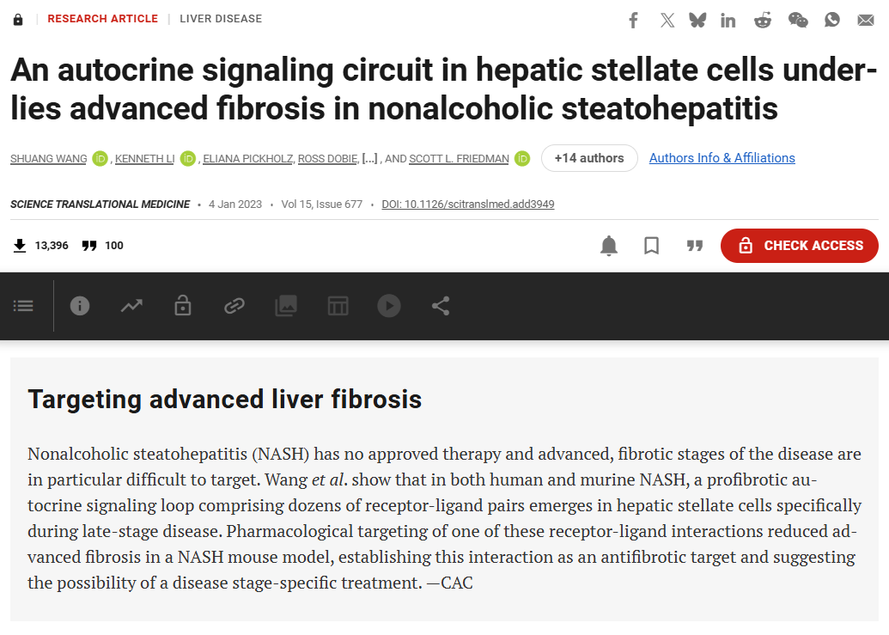

Slide 3
Data preprocessing workflow
read counts
create Seurat object
calculate QC metrics
filter low‑quality cells
normalize and scale data
identify highly variable features.

Slide 4
The read counts
Usually in a format of a set of matrices (the results), features (the genes), and barcodes (the cells).
May also be in the form of CSV, sometimes already pre-processed.
Determines the starting point of the analysis.

Slide 5
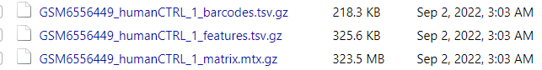
Example set of read counts

Slide 6
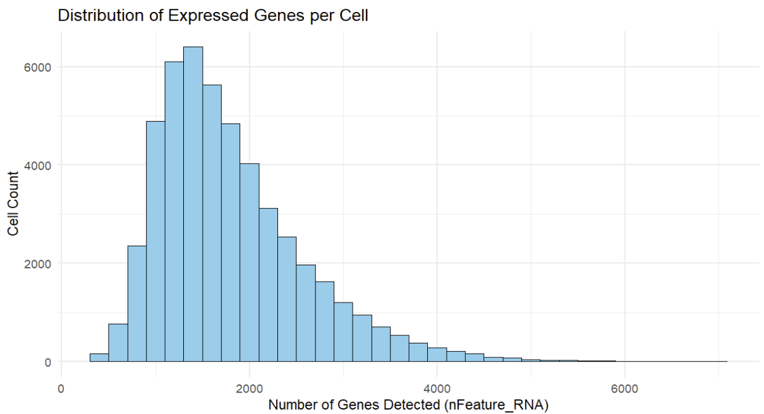
The number of reads (genes) in ScRNA-Seq

Slide 7
Quality control metrics
Number of genes per cell
Percentage of mitochondrial reads
Objectives: removal of doublets, empty, and broken cells

Slide 8
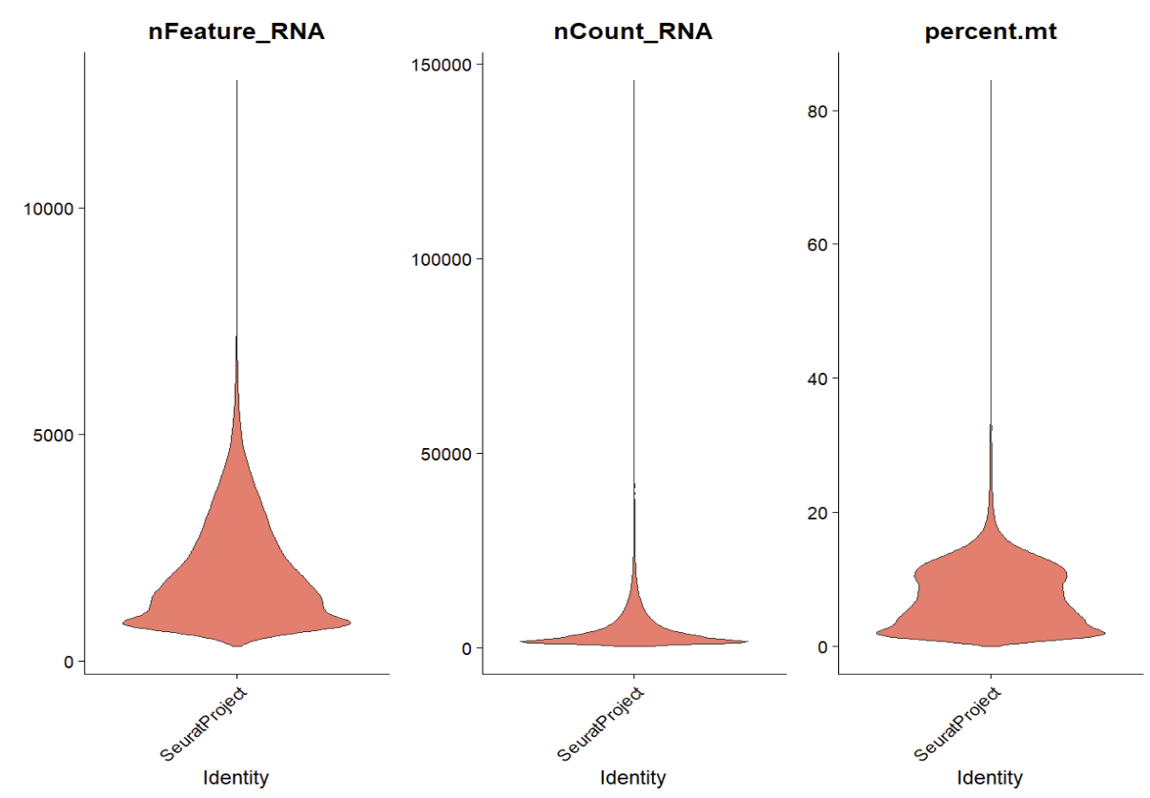
Quality control in action

Slide 9
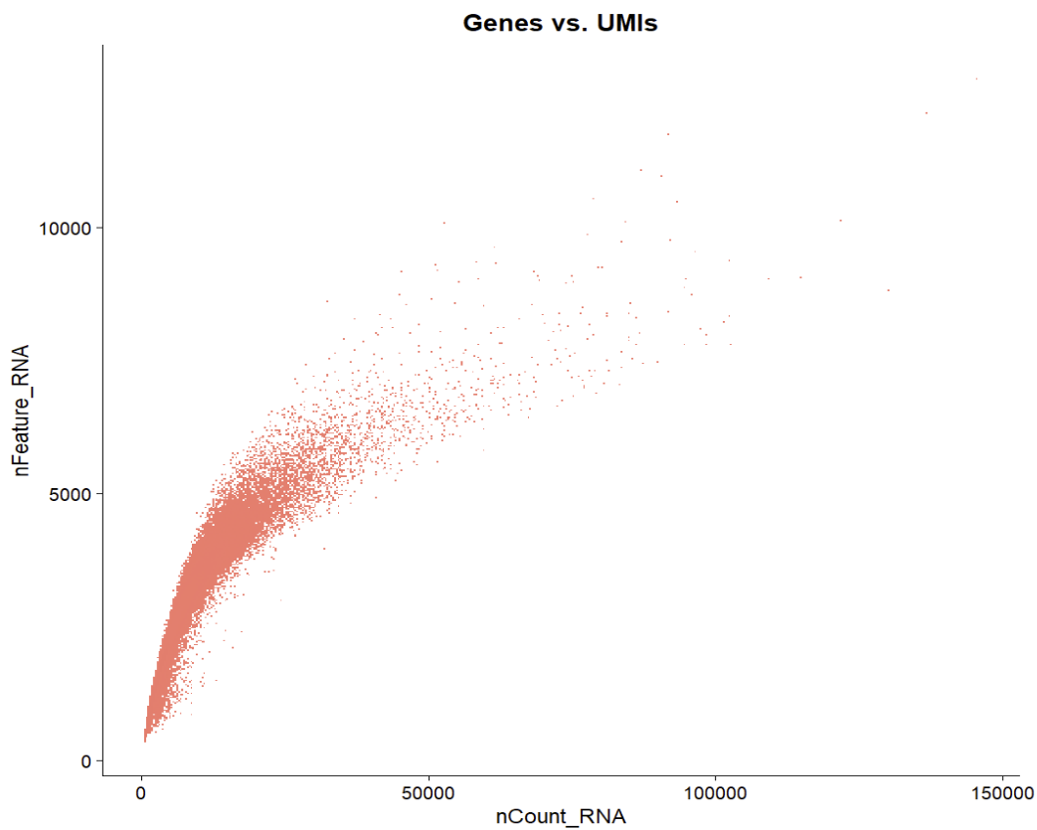
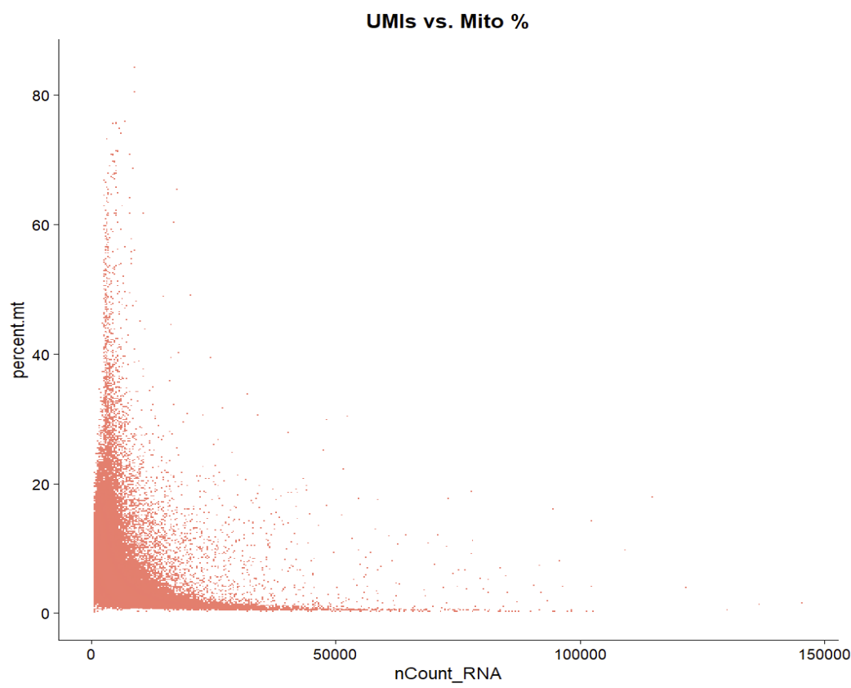
How should we interpret the metrics?

Slide 10
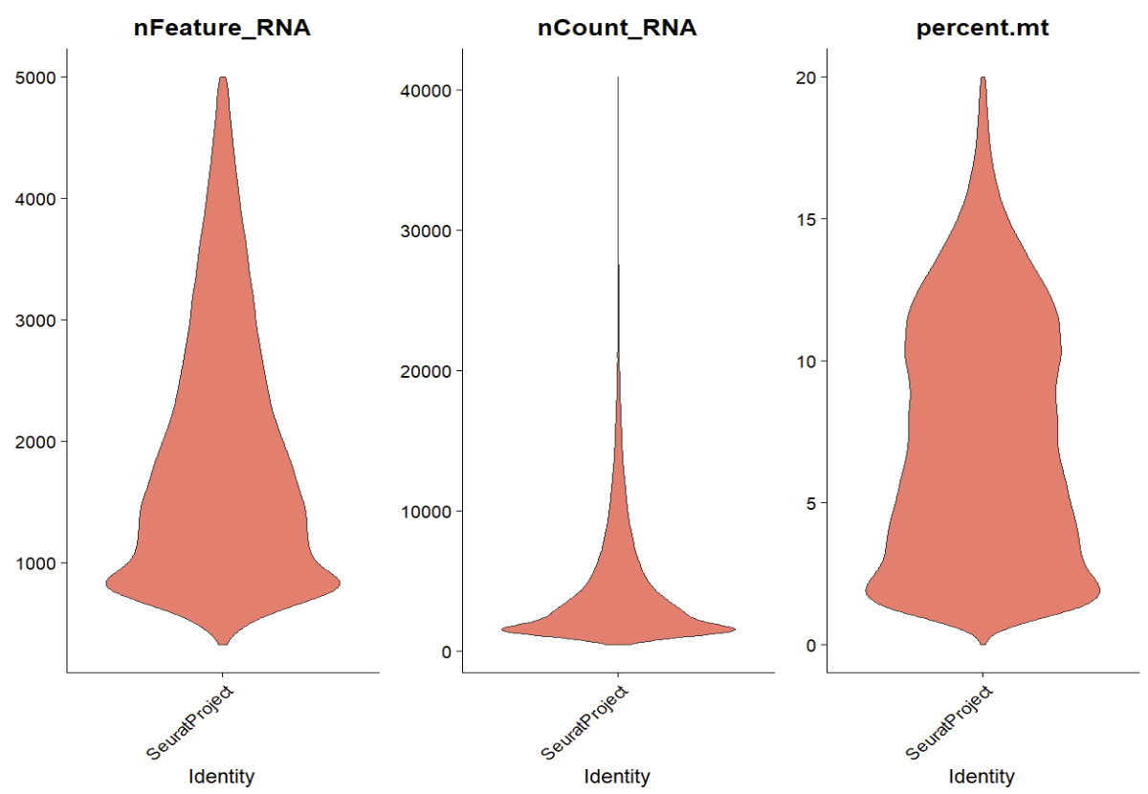
Results after QC

Slide 11
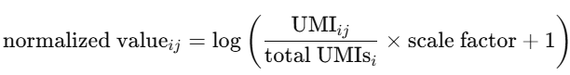
Normalization and variance stabilization
Normalization is needed because each cells is sequenced with different depths
For example, one cell might be sequenced with 50,000 reads, while another only has 5,000 reads.

Slide 12
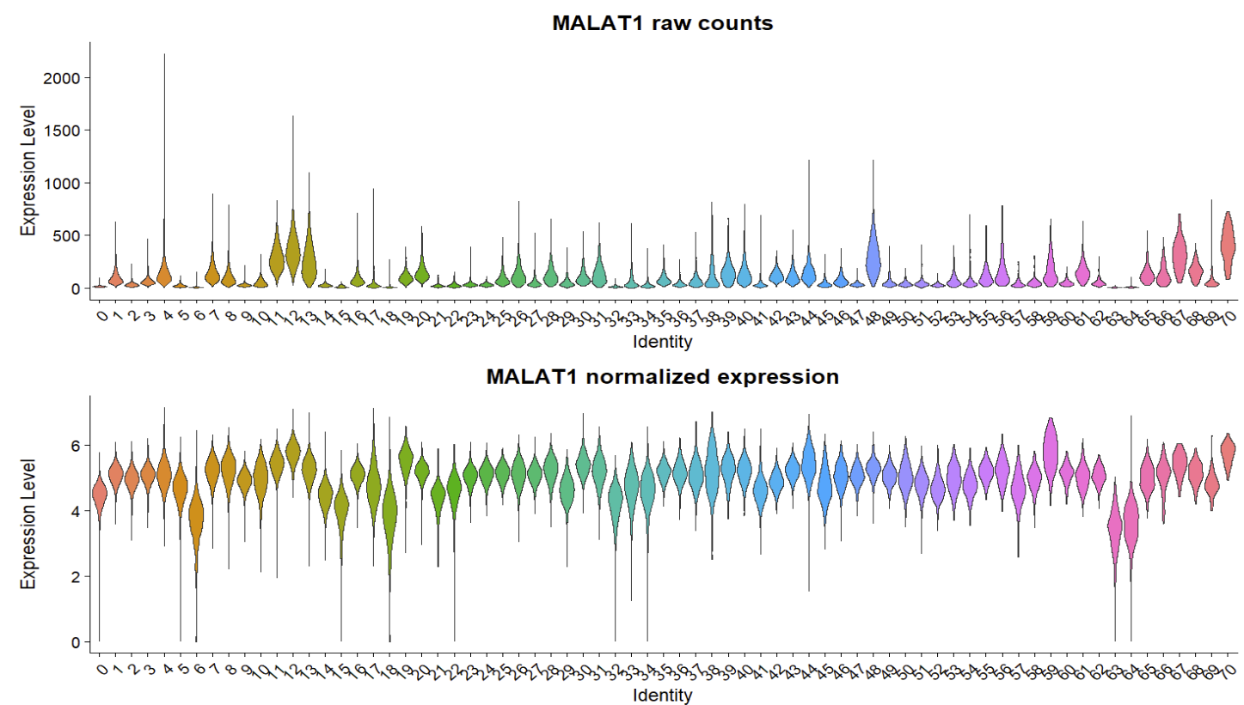

Slide 13
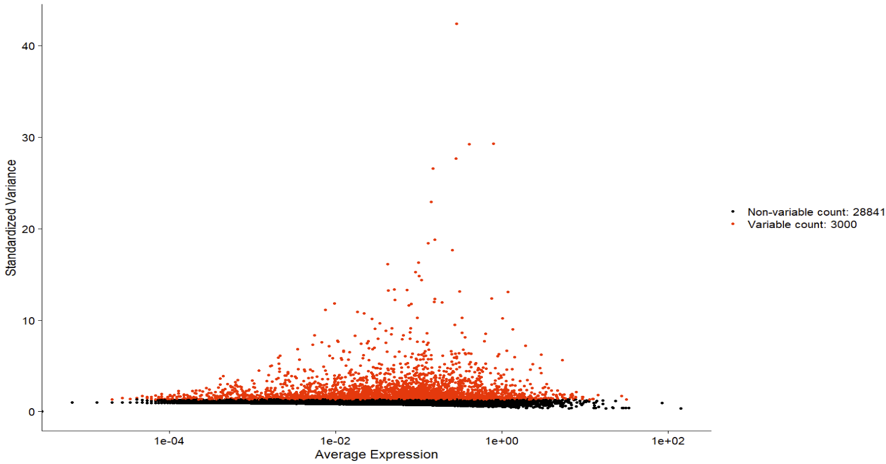
Feature selection and scaling
We use Seurat’s FindVariableFeatures function.

Slide 14
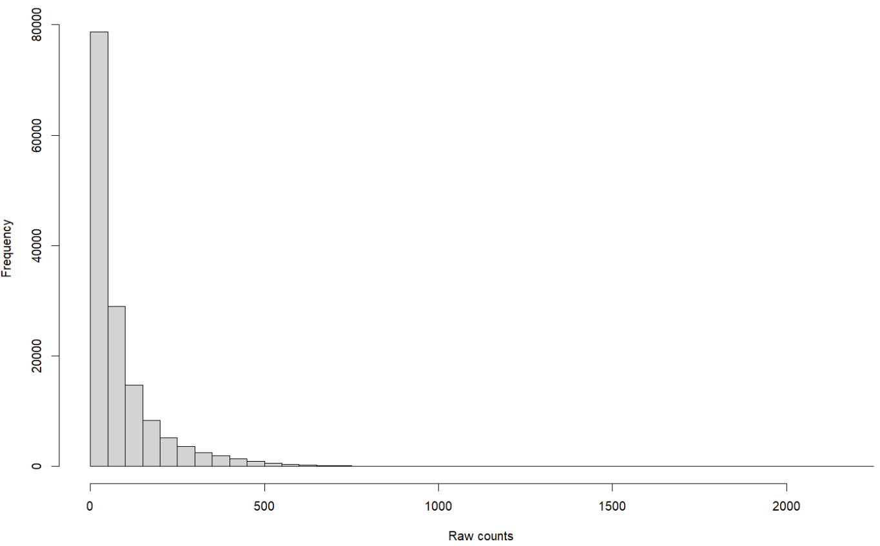
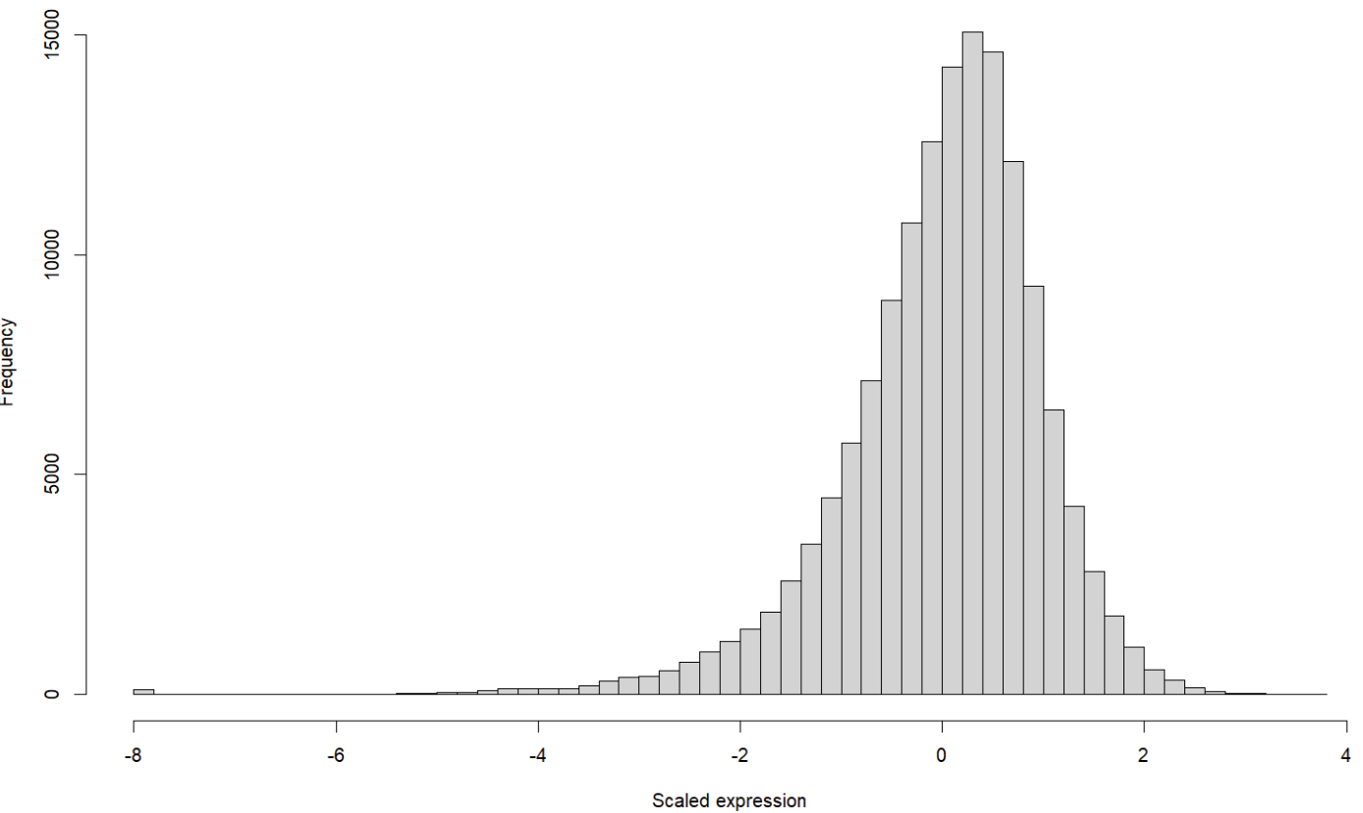
Scaling
Scaling gene expression to zero mean and unit variance
Essential for Principle Component Analysis

Slide 15
Dimensionality reduction
scRNA-seq has thousands of genes (features) → too high-dimensional to visualize or cluster directly.
PCA finds new axes (principal components, PCs) that capture the largest sources of variation in the data.
Why its needed?
Noise reduction: keeps the signal, discards random noise.
Computational efficiency: clustering on 10–50 PCs is much faster than on 20,000 genes.
Interpretability: PC loadings show which genes drive the variation.

Slide 16
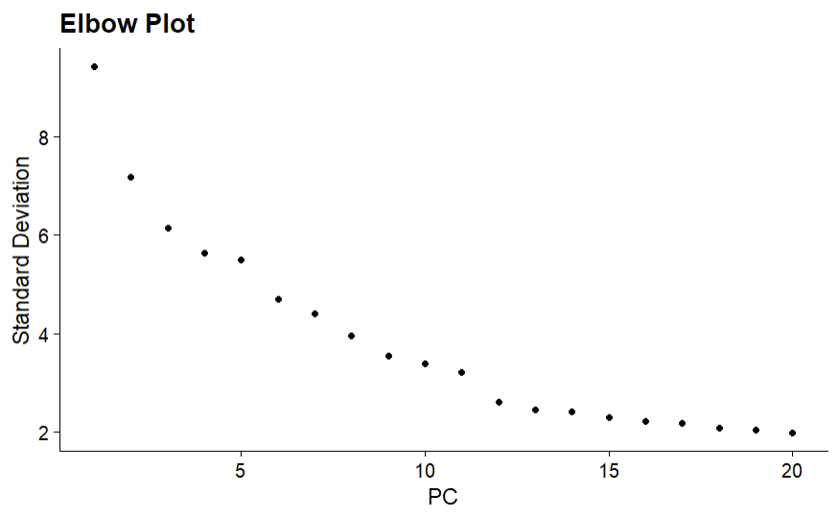
Picking PCs: The Elbow Plot

Slide 17
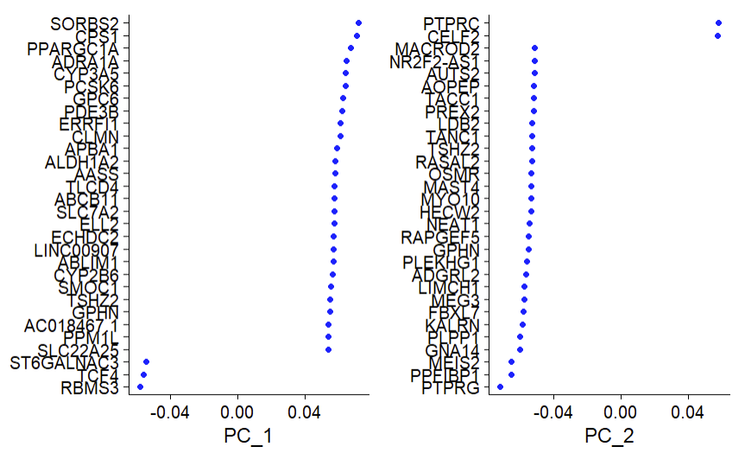
PC is a linear combination of genes

Slide 18
Non-Linear Embeddings and Visualizations
PCA reduces dimensions linearly, but it may miss non-linear structures in single-cell data.
Non-linear methods like UMAP (Default in Seurat) embed cells into 2D or 3D to make clusters more visually apparent.

Slide 19
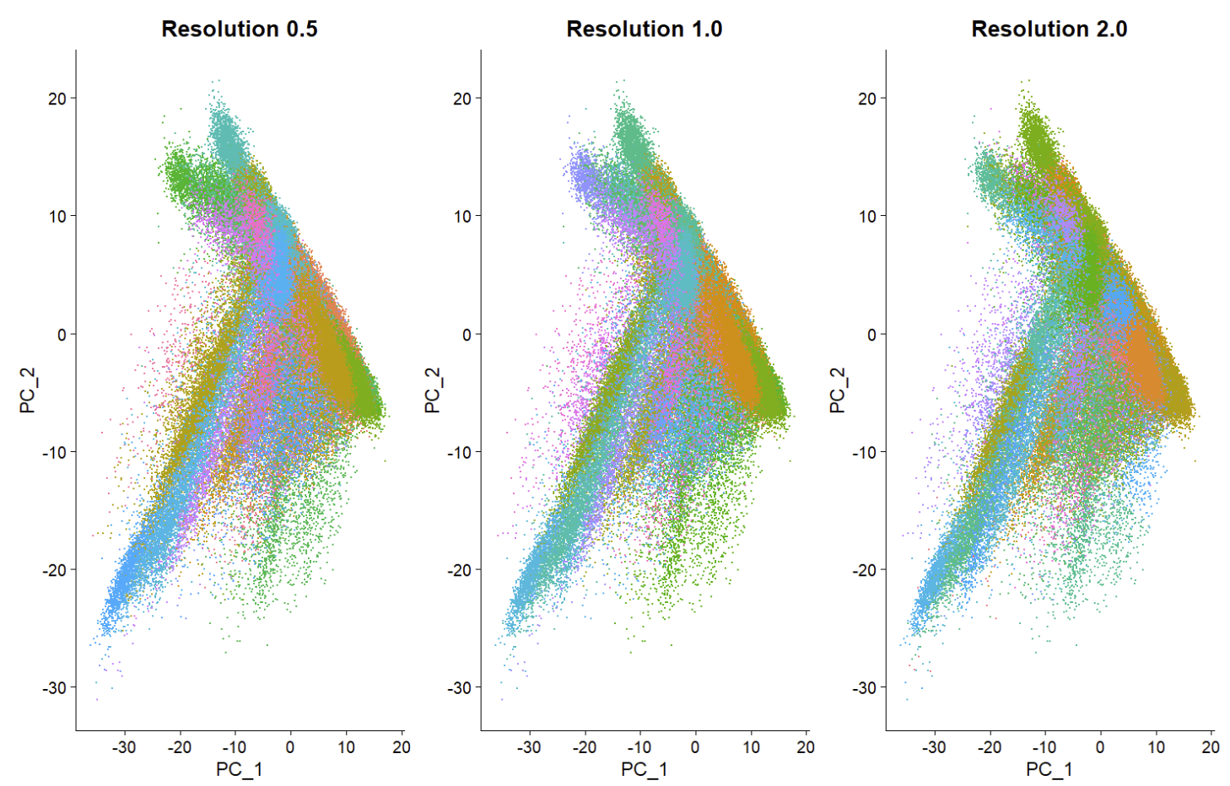
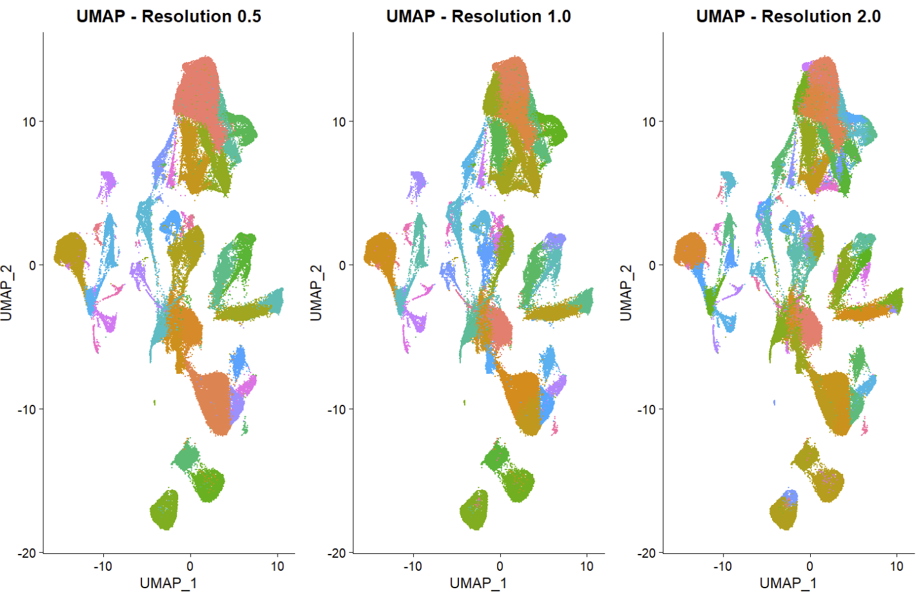
PCA vs UMAP for Visualizations and Resolutions

Slide 20
Demo and Activities

